Slide 1
KICS Workshop
Checkmarx Professional Services

Slide 2
Agenda
Agenda
/01
/06
What is KICS
Support
/02
/07
Supported platforms
Contribute
/03
/08
Run KICS locally
KICS in CxOne
/04
Integrate KICS in Pipelines
/05
Edit/Create KICS security query

Slide 3
KICS explained
What is KICS
KICS stands for Kipping Infrastructure as Code Secure
Checkmarx product to find in IaC
Security issues
Compliance issues
Infrastructure misconfigurations
Open-source
Written in Golang using Open Policy Agent (OPA)
Security Queries written in Rego
Covers vulnerability check in AWS, GCP, Azure

Slide 4
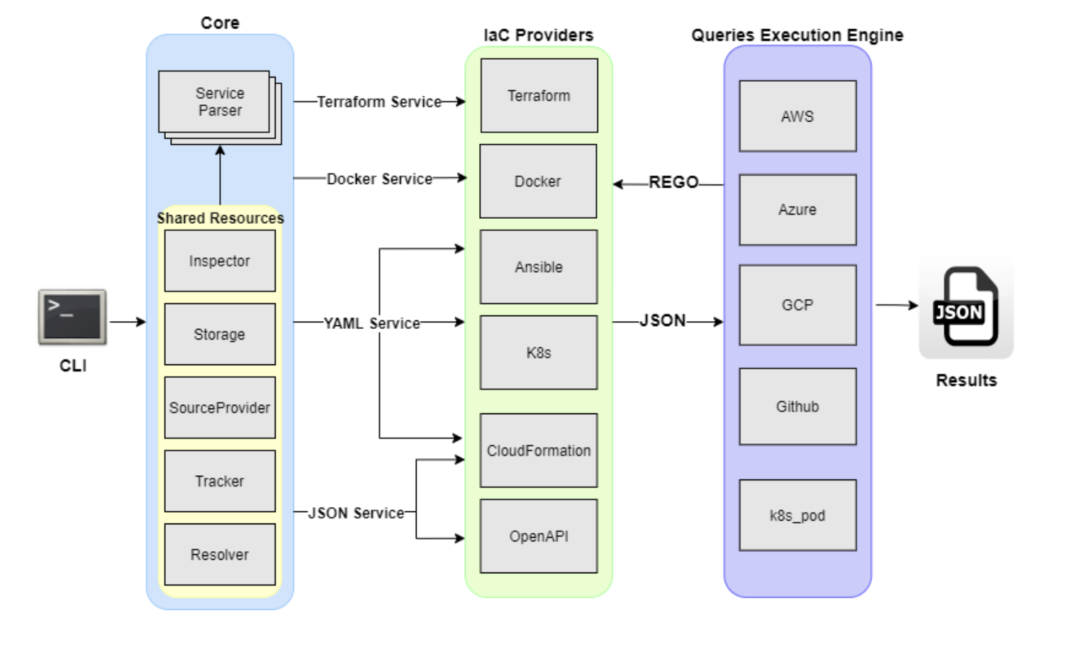
KICS architecture
What is KICS
Notes:
JSON is a payload - is the universal format of all files to scan
Is a array of documents

Slide 5




KICS Supported Platforms
Supported Platforms
Ansible
Azure Resource Manager
AWS CloudFormation
Crossplane
.yaml
.json
.json
.yaml
.yaml

Slide 6

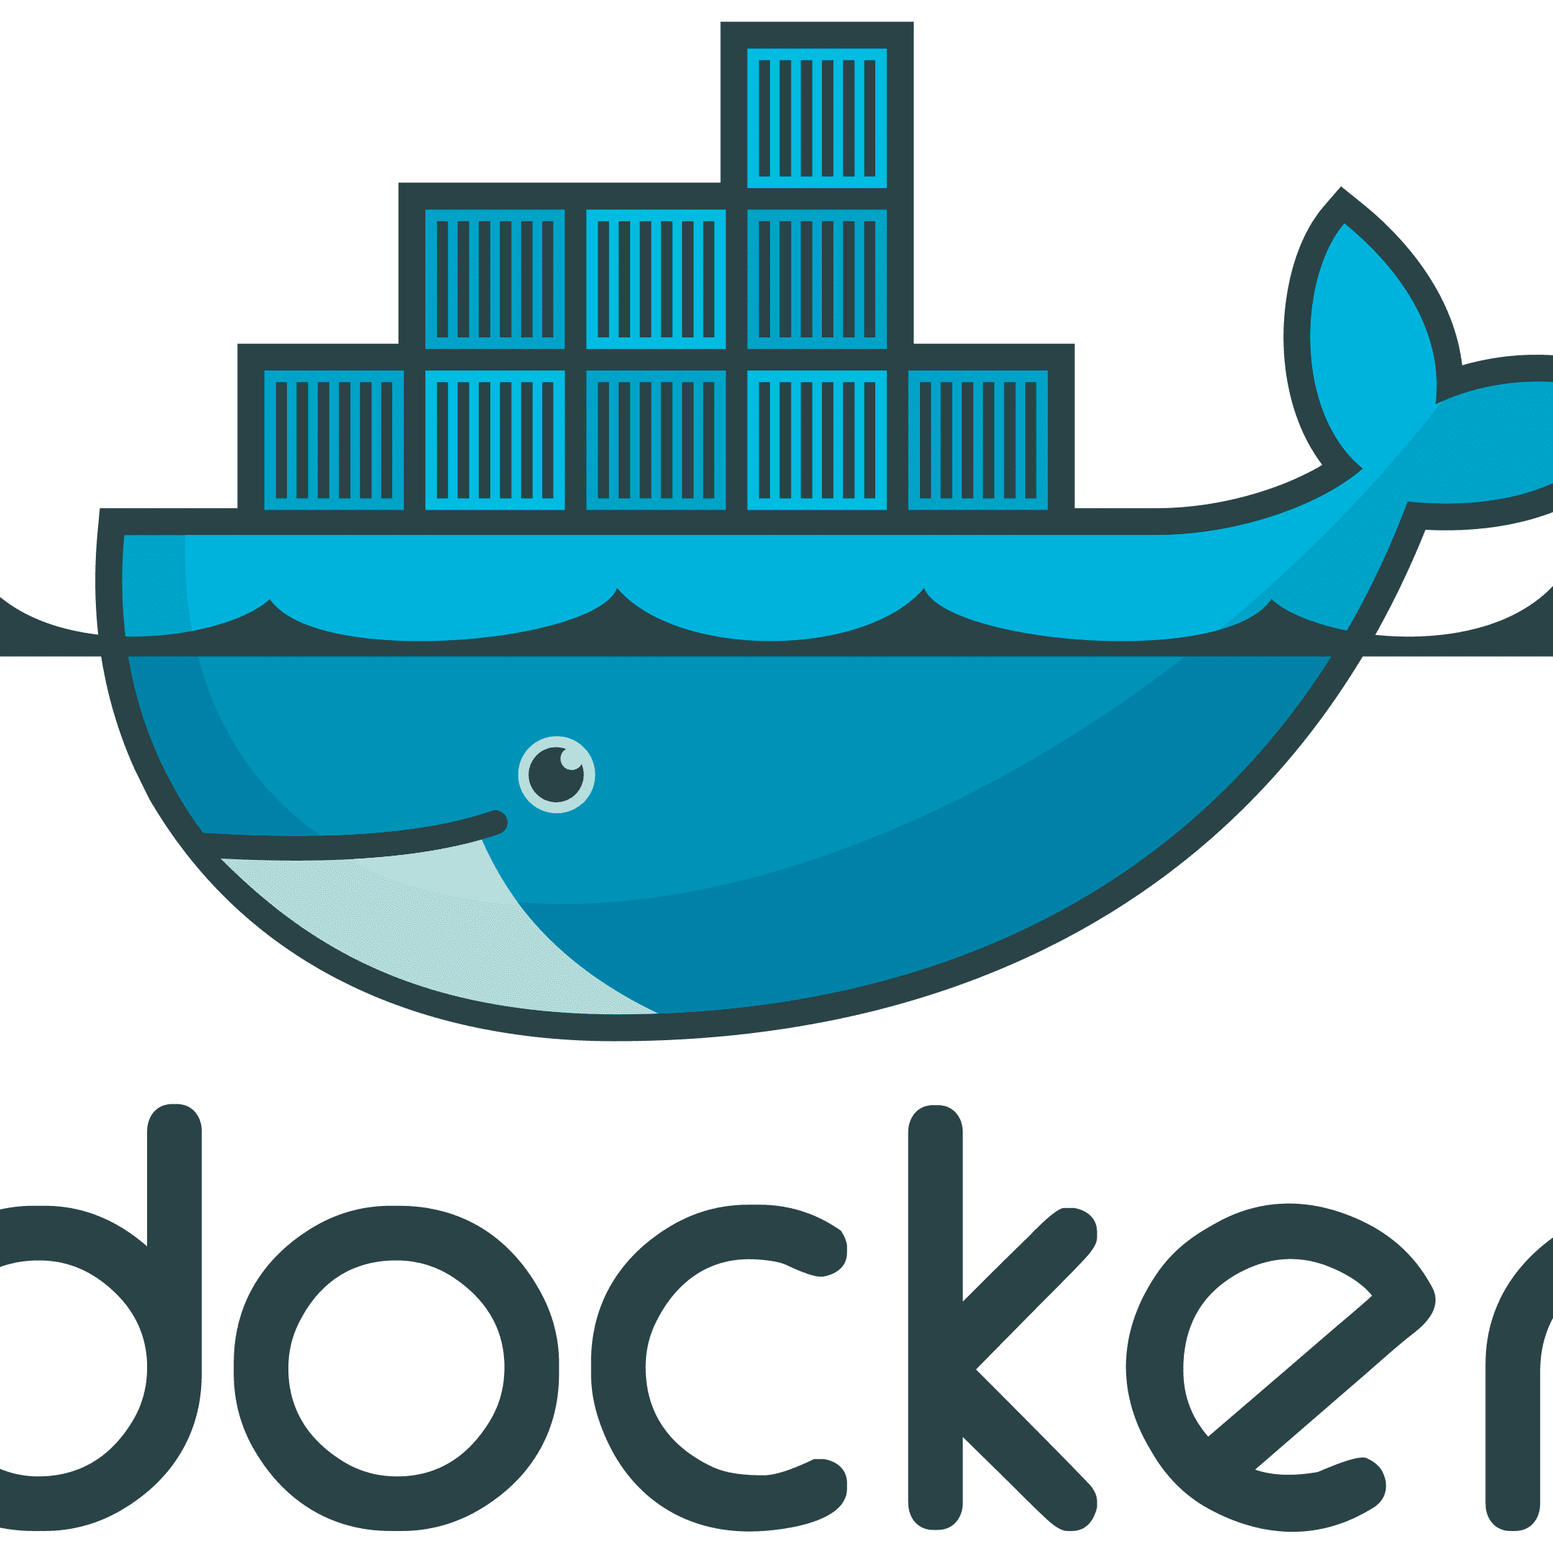


KICS Supported Platforms
Supported Platforms
Azure Blueprints
Docker
Docker Compose
gRCP
Google Remote Procedure Call
Note: For the queries porposes, this is recognized as Azure Resource Manager.
.json
.dockerfile
.yaml
.proto

Slide 7


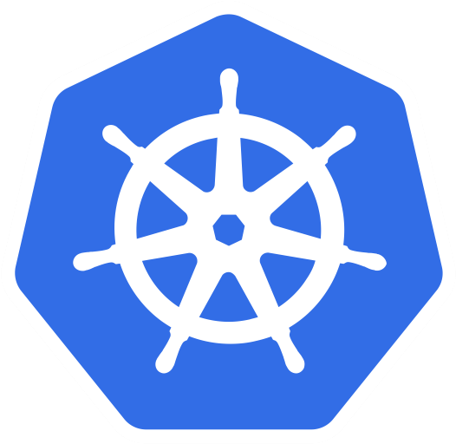

KICS Supported Platforms
Supported Platforms
Helm
Knative
Kubernetes
OpenAPI
Note: For queries porposes, this is recognized as Kubernetes.
.yaml
.yaml
.yaml
.json
.yaml
Swagger 2.0 and OpenAPI 3.0

Slide 8




KICS Supported Platforms
Supported Platforms
Pulumi
ServlessFW
Google Deployment Manager
AWS SAM Servless Application Model
.yaml
.yml
.yaml
Note: For queries porposes, this is recognized as Cloud Formation
.yaml

Slide 9

Supported Platforms
Supported Platforms
Terraform
Terraform Plan
.tf .terraform.tfvars .auto.tfvars
.json
...

Slide 10
Install KICS Windows locally
Run KICS on prime
Install go from https://golang.org/dl/
Clone KICS repo
git clone https://github.com/Checkmarx/kics.git
Build kics binaries
make build
Scan
./bin/kics scan -p '<path-of-your-project-to-scan>' --report-formats json -o ./results

Slide 11
Install KICS Docker
Run KICS on prime
Pre-requisit
Have docker running
Get the image
docker pull checkmarx/kics:latest
Run scan
docker run -t -v "{path_to_host_folder_to_scan}":/path checkmarx/kics scan -p "/path"-o "/path/"
Notes:
#TO RUN for a local scan
docker run -v /Users/soniadias/Desktop/KICSTrainingDemos/docker_helloWorld:/path checkmarx/kics:latest scan -p "/path" -o "/path" --report-formats "pdf"

Slide 12
Install KICS some flags
Run KICS on prime
-p
Path of the volume
docker run -v "C:\Users\soniad\Documents\kics":/path checkmarx/kics:latest scan -p "/path
docker run checkmarx/kics scan -p git::https://github.com/SoniaDias/docker_helloWorld
-v
to create a local volume sync with container volume
docker run -v "C:\Users\soniad\Documents\kics":/path checkmarx/kics:latest
-o
for the output folder
docker run -v "C:\Users\soniad\Documents\kics":/path checkmarx/kics:latest scan -p "/path" -o "/path"
Notes:
-p to pass the repo

Slide 13
Install KICS some flags
Run KICS on prime
--log-level DEBUG
-v verbose
docker run checkmarx/kics scan -p git::https://github.com/SoniaDias/docker_helloWorld --log-level DEBUG -v
-d or –payload-path to generate the payload
JSON model(to be explained in queries module, some slide ahead)
Notes:
-v very usefull if some error happen, or to see what is executed in general
-d to generate a json payload which is a json representation of the files that will be scanned

Slide 14
Install KICS reporting
Run KICS on prime
https://docs.kics.io/latest/commands/
Flag
--report-formats
Supported
--report-formats "glsast"
--report-formats "all"
--report-formats "sarif"
--report-formats "junit"
--report-formats "sonarqube"
--report-formats "html"
--report-formats "pdf"
--report-formats "cyclonedx"
--report-formats "asff"
--report-formats "csv"
--report-formats "codeclimate"

Slide 15
Install KICS - DEMO
Run KICS on prime
Get KICS docker image
Execute a KICS scan in a local folder
The folder can be cloned from
https://github.com/SoniaDias/docker_helloWorld
Notes:
#pull the image
docker pull checkmarx/kics:latest
#run a scan
docker run -v /Users/soniadias/Desktop/KICSTrainingDemos/docker_helloWorld:/path checkmarx/kics:latest scan -p "/path" --no-progress
#run a scan generating a default report
docker run -v /Users/soniadias/Desktop/KICSTrainingDemos/docker_helloWorld:/path checkmarx/kics:latest scan -p "/path" -o /path
#run a scan and generate a report
docker run -v /Users/soniadias/Desktop/KICSTrainingDemos/docker_helloWorld:/path checkmarx/kics:latest scan -p "/path" -o "/path" --report-formats "pdf"

Slide 16
Install KICS – useful documentation
Run KICS on prime
https://docs.kics.io/latest/documentation/
https://github.com/Checkmarx/kics/blob/master/docs/getting-started.md

Slide 17
CI/CD Pipelines
Integrate KICS with Pipelines
Supported pipelines
https://github.com/Checkmarx/kics/blob/master/docs/integrations.md
For this workshop, will be used
GiHubActions
Azure DevOps
Code being scanned
Azure Resource Manager (ARM) .json
https://github.com/SoniaDias/Azure-Resource-Manager-ARM-Example

Slide 18
CI/CD Pipelines – GitHub Actions DEMO
Integrate KICS with Pipelines
Referrer links
https://github.com/Checkmarx/kics/blob/master/docs/integrations_ghactions.md
https://docs.kics.io/latest/integrations_ghactions/

Slide 19
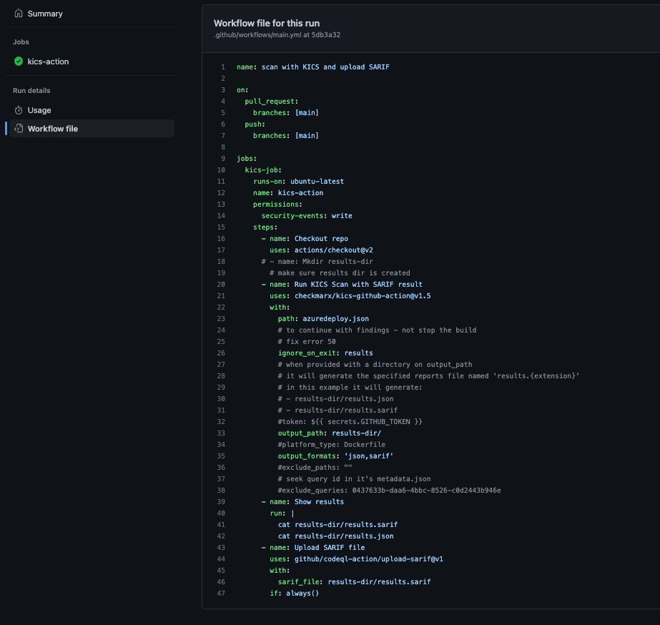
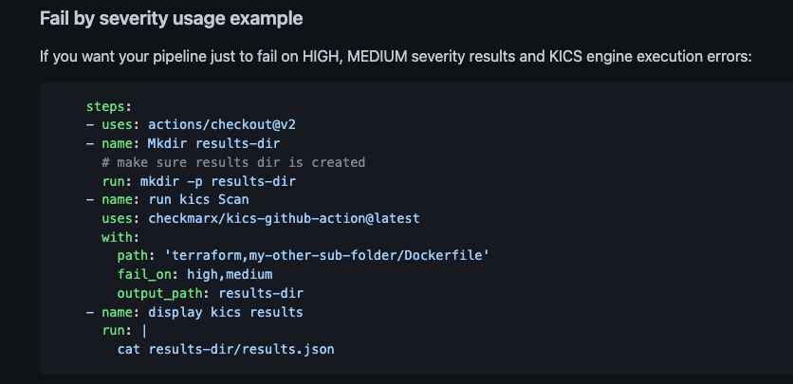
CI/CD Pipelines – GitHub Actions DEMO
Integrate KICS with Pipelines

Slide 20
CI/CD Pipelines – Azure DevOps DEMO
Integrate KICS with Pipelines
Referrer links
https://docs.kics.io/latest/integrations_azurepipelines/
https://github.com/Checkmarx/kics/blob/master/docs/integrations_azurepipelines.md

Slide 21
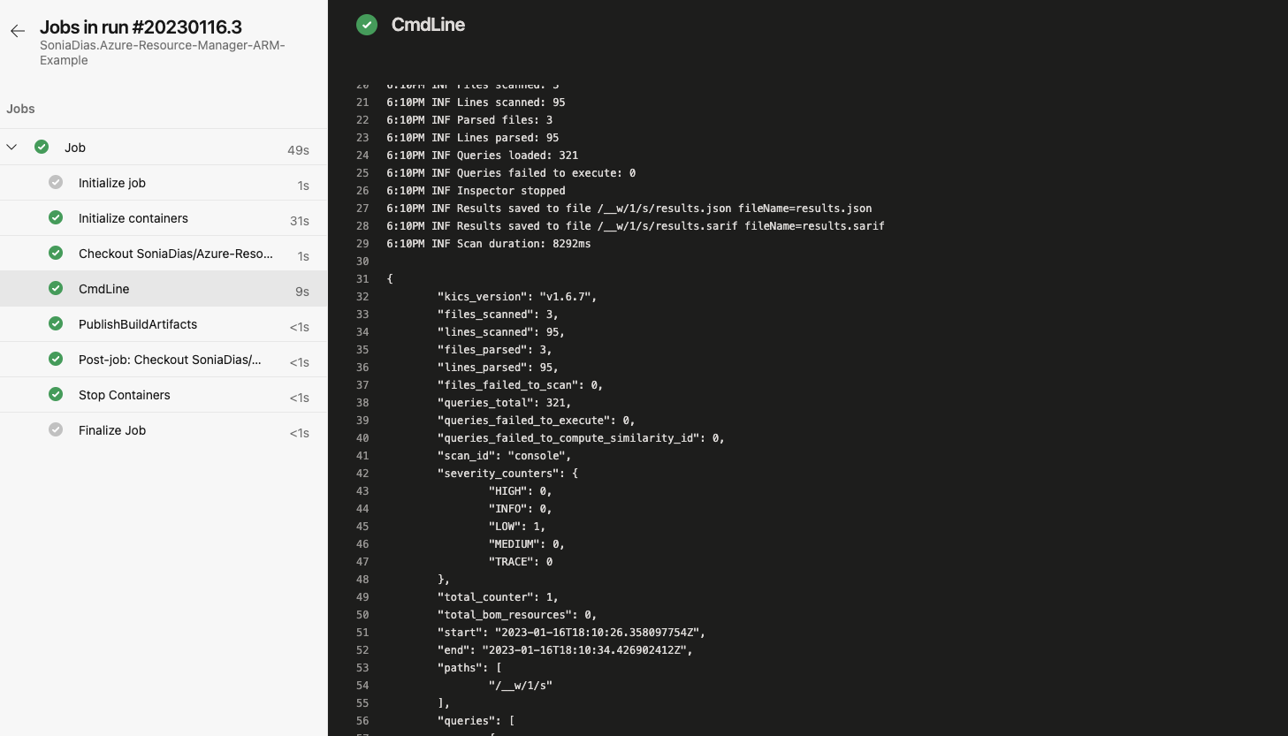
CI/CD Pipelines – Azure DevOps DEMO
Integrate KICS with Pipelines

Slide 22
CI/CD Pipelines – useful documentation
Integrate KICS with Pipelines
https://github.com/Checkmarx/kics/blob/master/docs/integrations.md
https://docs.kics.io/latest/integrations/

Slide 23
KICS Security Queries
KICS Security Queries
KICS gets the IaC file to scan and internally creates a JSON file in a universal format
Same structure for almost all platforms being scanned
So,
You pass a .tf or a .yaml file
KICS generates a .json from it
This JSON is an internal representation of the code being scanned
Array of Documents

Slide 24
KICS Security Queries
KICS Security Queries
The KICS queries will be executed in this JSON file
If we want to edit our queries to remove or add results, generate this file is our first step
The JSON can be outputted so the user of KICS can see what is going to be scanned
To obtain the JSON file use –d <path of the file> or - - payload-path <path of the file>

Slide 25
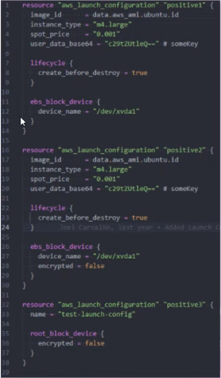
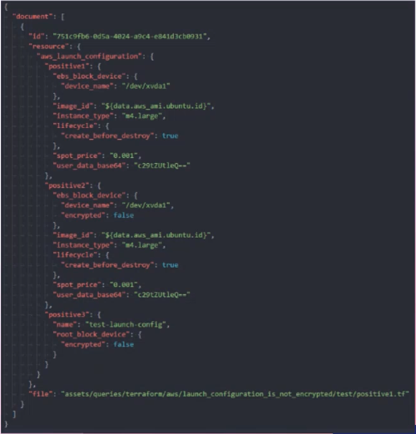
KICS Security Queries – json creation
KICS Security Queries
Notes:
GENERAL
AWS Launch configuration
Resource type name

Slide 26
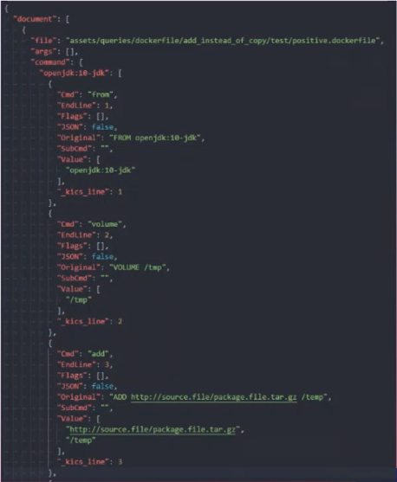
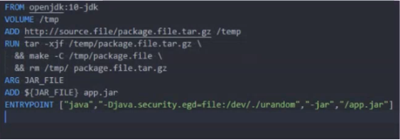
KICS Security Queries – JSON creation
KICS Security Queries
Notes:
DOCKER – SPECIAL CASE
We don’t have “Resource type name” but a list of commands

Slide 27
KICS Security Queries
KICS Security Queries
We have the JSON file
We need to create positive and negative cases
We need to create out metadata.json
We need to write our security queries
The security queries in KICS are written in rego

Slide 28
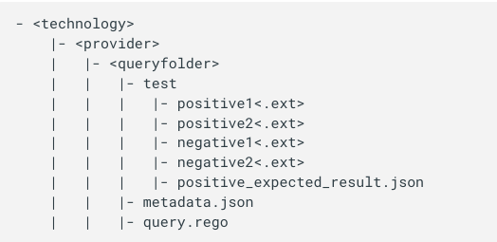
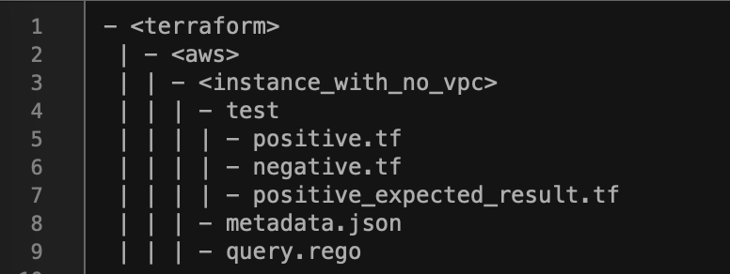
KICS Security Queries – query file tree
KICS Security Queries
Notes:
Example: terraform aws EC2 – instance with no vpc
(SHOW IN kics FOLDER)

Slide 29
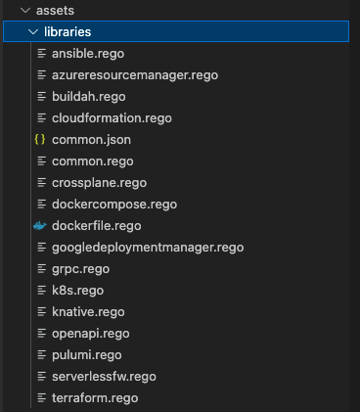
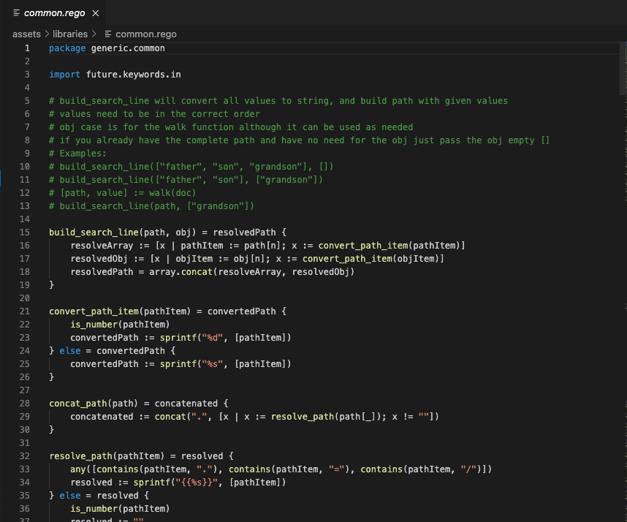
KICS Security Queries – libraries
KICS Security Queries

Slide 30
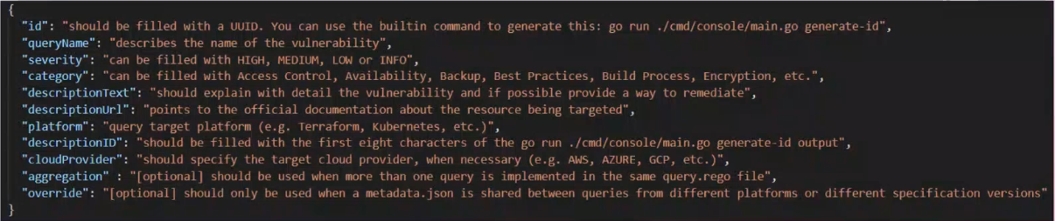
KICS Security Queries - metadata
KICS Security Queries

Slide 31
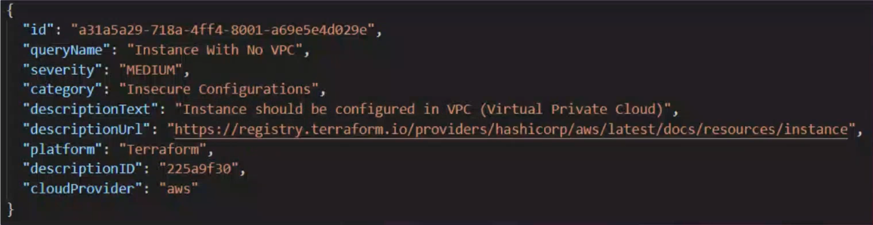
KICS Security Queries - metadata
KICS Security Queries
Terraform AWS EC2 with no VPC example

Slide 32
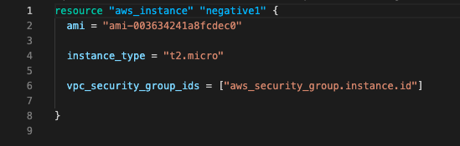
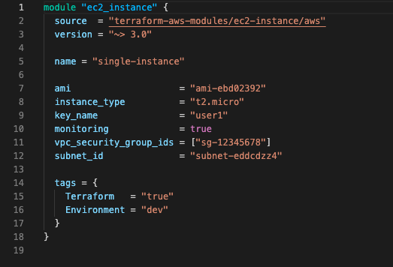
KICS Security Queries – negative.tf
KICS Security Queries
No result to be outputted
The condition that needs to be verified so there is no vulnerability
Notes:
No result to be outputed, is out

Slide 33
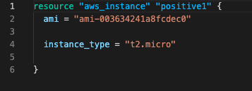
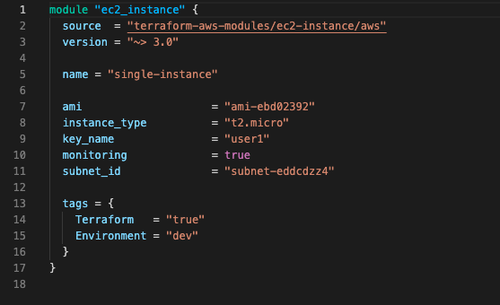
KICS Security Queries – positive.tf
KICS Security Queries
What outputs a result
The condition that needs to be verified so there is a security vulnerability
Notes:
No result to be outputed, is out

Slide 34
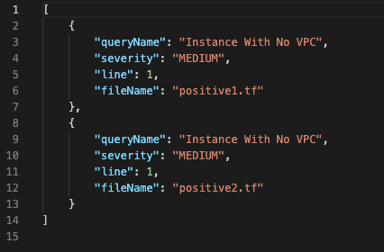
KICS Security Queries – expected.tf
KICS Security Queries
Is expected a. output being created is conditions on positive_expected_result.json are met – meaning is vulnerable
Notes:
No result to be outputed, is out

Slide 35
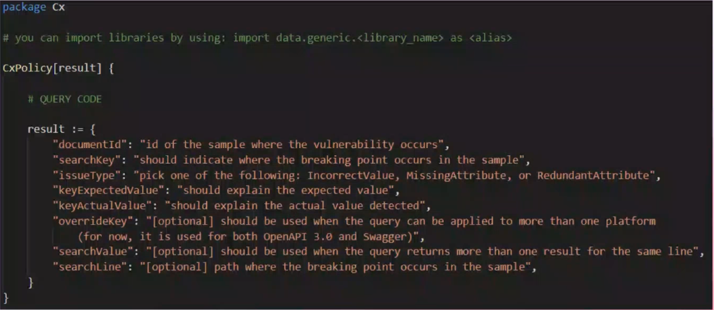
KICS Security Queries – query.rego
KICS Security Queries
Notes:
If you are using KICS libarries, you need to import packec Cx

Slide 36
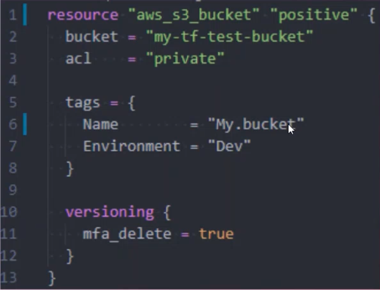
KICS Security Queries – query.rego
KICS Security Queries
Search key
String representation of what you are looking for in the file
KICS will look for it in the file
Special charcaters
=
Is the value in key=value
.
Break line
{{}}
Ignore special characters
[]
Same line
Notes:
If you are using KICS libarries, you need to import packec Cx

Slide 37
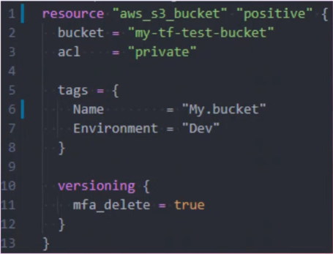
KICS Security Queries – query.rego
KICS Security Queries
Search line
Uses JSON path to find line
Uses common lib function build_search_line
It receives 2 arrays
First array is the path
Last array can be empty
Notes:
If you are using KICS libarries, you need to import packec Cx

Slide 38
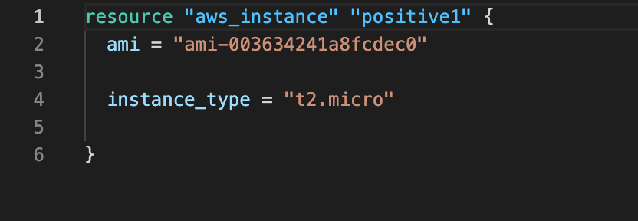
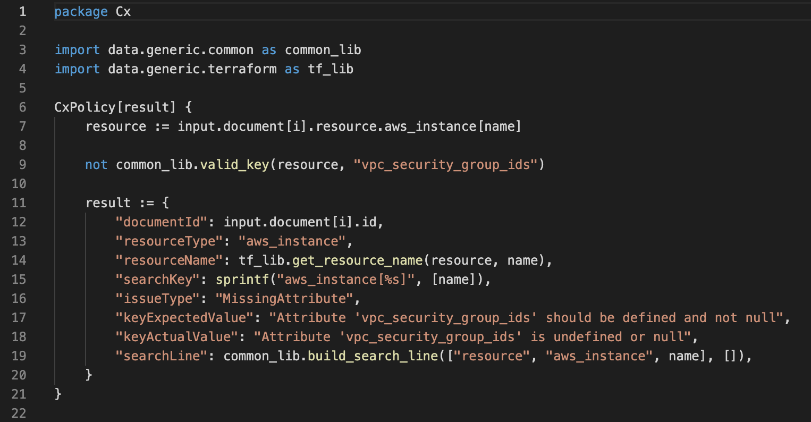
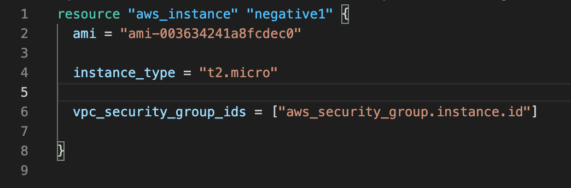
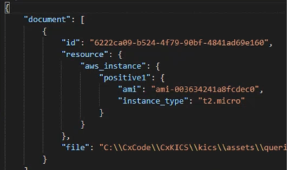
KICS Security Queries – query.rego
KICS Security Queries
In our Instance with no VPC example
Notes:
Valide_key – verifies if the vpc_security_group_id exists inside the object resource
(if you want to see the method just go to the code folder)

Slide 39
KICS Security Queries – useful functions
KICS Security Queries
valid_key (obj, key)
Receives object and key that needs to be checked
Checks if the key exists or not
json_unmarshall(json)
Deserializes a JSON encoded string to a term
Receives a JSON string as argument
Returns an empty JSON is there is no string
walk(x, [path, value])
Creates a path and value pair for documents under x – x is the resource (an array)

Slide 40
KICS Security Queries DEMO
KICS Security Queries
Create a query that finds Terraform resources with encryption disabled
Encryption should be set to false
Use walk function
Resources
query_development_training_encryption_disabled zip
Docker
Rego Playground to test the code, https://play.openpolicyagent.org/

Slide 41
KICS Security Queries DEMO
KICS Security Queries
Create the query with the help of rego playground
Edit the /query_development_training/query_development_training_encryption_disabled/query.rego based on /query_development_training/payload.jsonpayload.json
Get docker image of KICS and execute the query
docker pull checkmarx/kics:latest
docker run -v /YOUR_PATH_TO_THE_QUERY:/query checkmarx/kics:latest scan -p /query -q /query --no-progress
Note: to verbose execution add –v in the end
Note2: to create a report add –o /query --report-formats "pdf”
Note3: to create a JSON respresentation
Notes:
On Rego Playground page:
-input is the payload
-Rego Playground is our query.rego
#TO RUN for run the query
docker run -v /Users/soniadias/Desktop/KICSTrainingDemos/query_development_training/query_development_training_encryption_disabled:/query checkmarx/kics:latest scan -p /query -q /query --no-progress
#to verbose add
-v
#to generate the json representation of the document
-d /query/payload.json
#to generate a report with the security issues foud
-o /query --report-formats "pdf”
#query.rego
package Cx
import data.generic.common as common_lib
CxPolicy[result] {
# access to any document
doc := input.document[i]
# access the resource object on doc
resource := doc.resource
# walk into the resource to find field encrypted
[path, value] = walk(resource)
value.encrypted == false
result := {
"documentId": doc.id,
"debug": sprintf("%s.encrypted", [path]),
"searchKey": sprintf("%s.encrypted", [common_lib.concat_path(path)]),
"issueType": "IncorrectValue",
# "keyExpectedValue": sprintf("%s.encrypted is set to true", [concat_path(path)]),
"keyExpectedValue": "encrypted is set to true",
"keyActualValue": sprintf("%s.encrypted is set to false", [common_lib.concat_path(path)]),
"searchLine": common_lib.build_search_line(path, ["encrypted"]),
}
}

Slide 42
KICS Security Queries – important links
KICS Security Queries
https://github.com/Checkmarx/kics/blob/master/docs/queries.md
https://docs.kics.io/latest/queries/

Slide 43
KICS Support
KICS Support
https://github.com/Checkmarx/kics/issues
https://github.com/Checkmarx/kics/issues/5559#issuecomment-1246576485
https://github.com/Checkmarx/kics/discussions

Slide 44
KICS how to contribute?
KICS How to Contribute
https://docs.kics.io/latest/CONTRIBUTING/

Slide 45
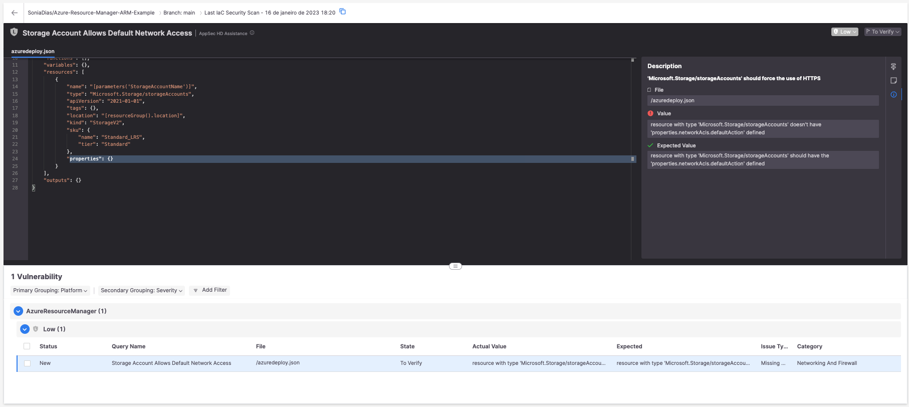
KICS in CxOne
KICS in CxOne

Slide 47
To create a slide
Choose a layout style and duplicate the slide. We recommend duplicating the slide so all visible elements are copied from the Master Slide.

